Slide 1

Microservices with Spring

Slide 2
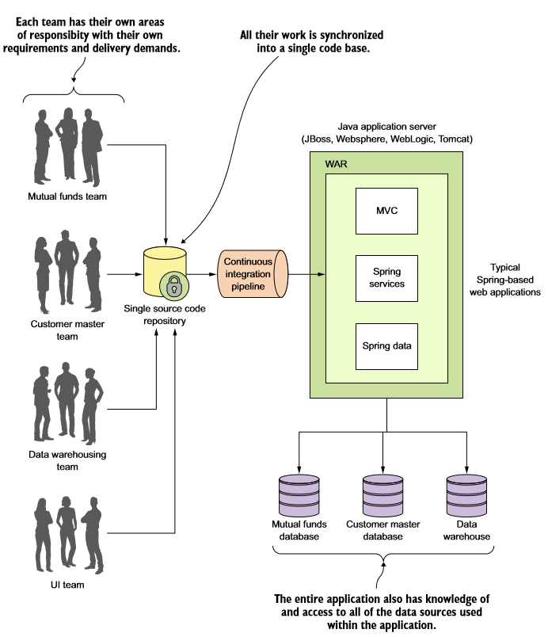
What´s a microservice?

Slide 3
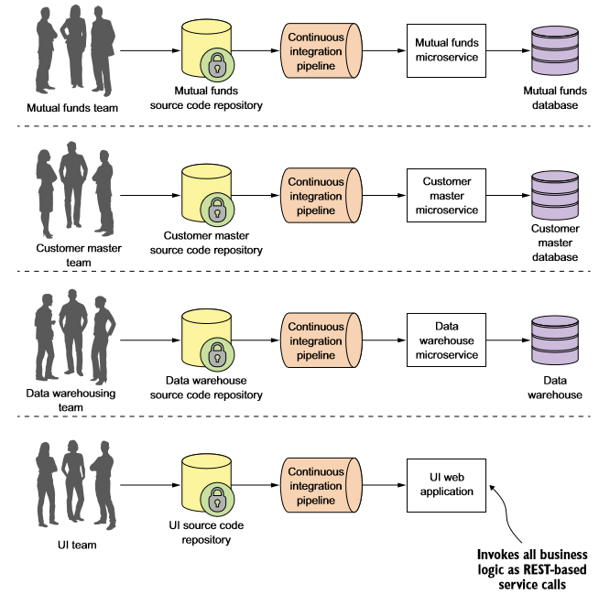
What´s a microservice?

Slide 4
Building microservices with Spring Boot

Slide 5
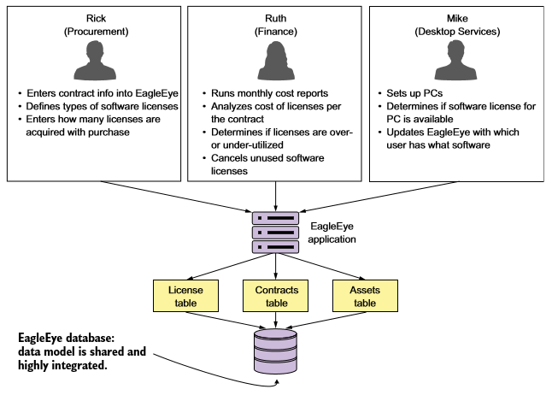
Building a microservice with Spring Boot

Slide 6
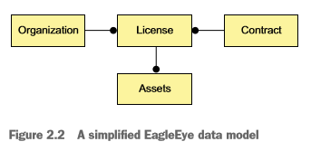
Building a microservice with Spring Boot

Slide 7
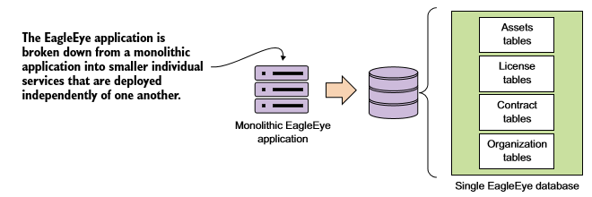
Establishing service granularity

Slide 8
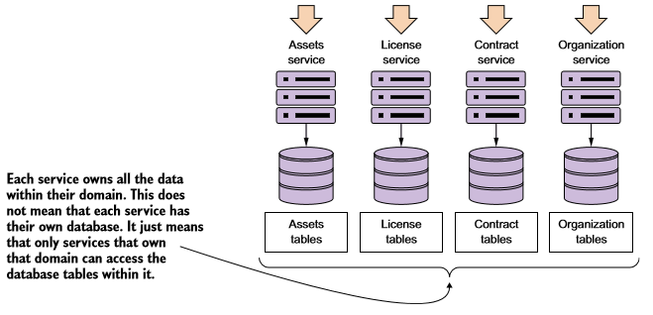
Establishing service granularity

Slide 9
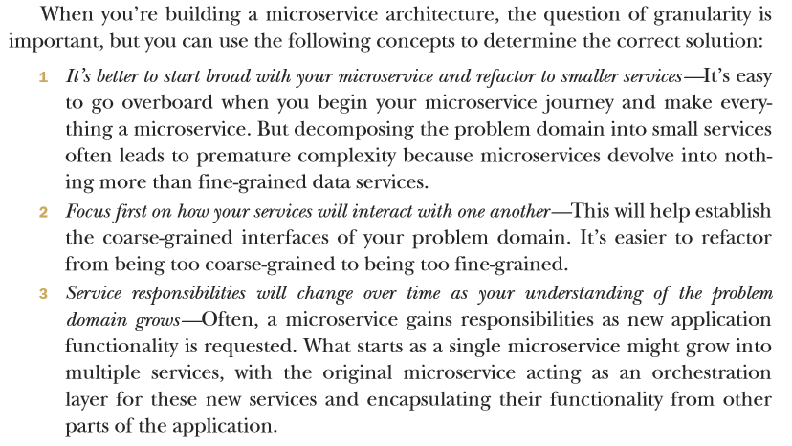
Establishing service granularity

Slide 10
Service interfaces
REST → HTTP (GET, PUT, POST and DELETE)
URI´s to communicate intent
JSON for request and responses
HTTP status codes (for failure and success!)

Slide 11
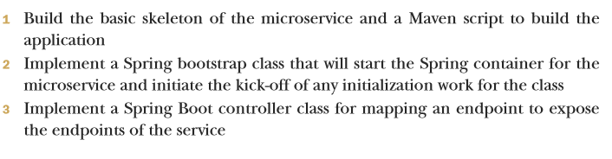
Building a microservice with Spring Boot and Java

Slide 12
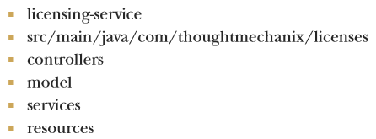
Getting started with the skeleton project
directory structure:

Slide 13
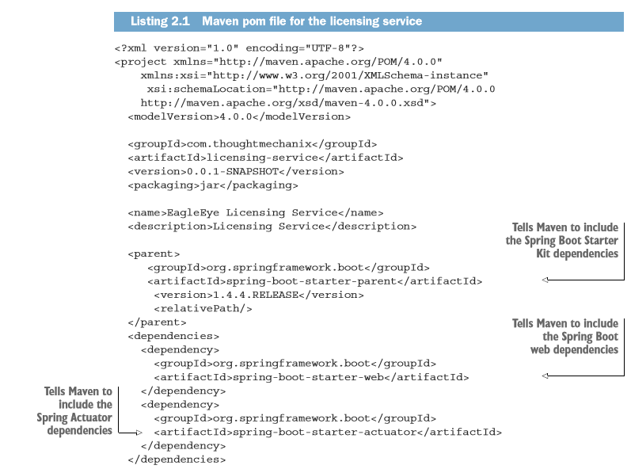
Getting started with the skeleton project
Writting the Maven script for the project (pom.xml):

Slide 14
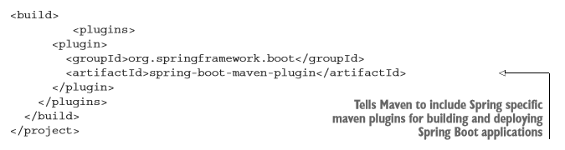
Getting started with the skeleton project
Writting the Maven script for the project (pom.xml):

Slide 15
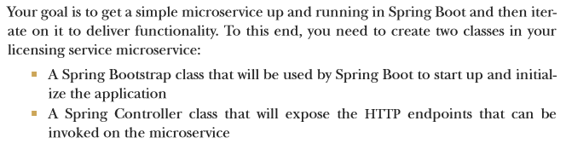
Booting your Spring Boot application

Slide 16
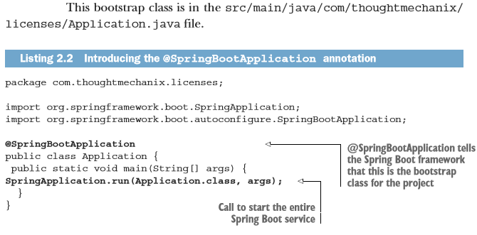
Booting your Spring Boot application

Slide 17
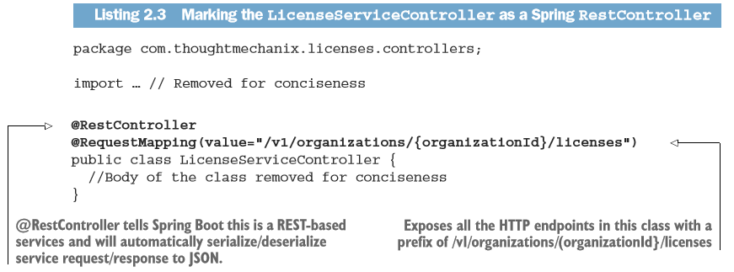
Building the doorway into the microservice: the Spring Boot controller

Slide 18
Why JSON for microservices?
Extremly lightweight (compared to other protocols such as the XML-based SOAP)
Simply to read for human (debugging)
JSON is the default serialization protocol used in JavaScript

Slide 19
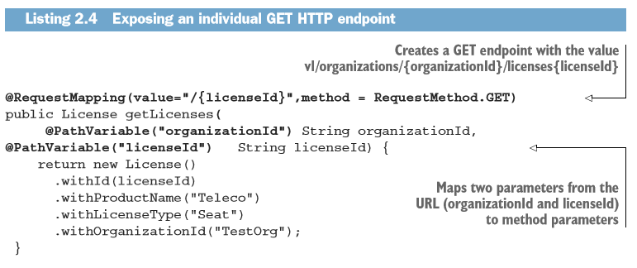
Building a microservice with Spring Boot and Java

Slide 20
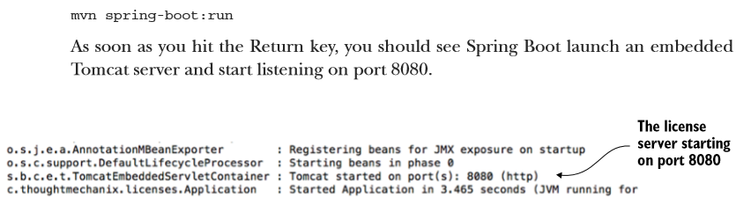
Building a microservice with Spring Boot and Java
Run the following Maven command in the project directory in the samlpe code:

Slide 21
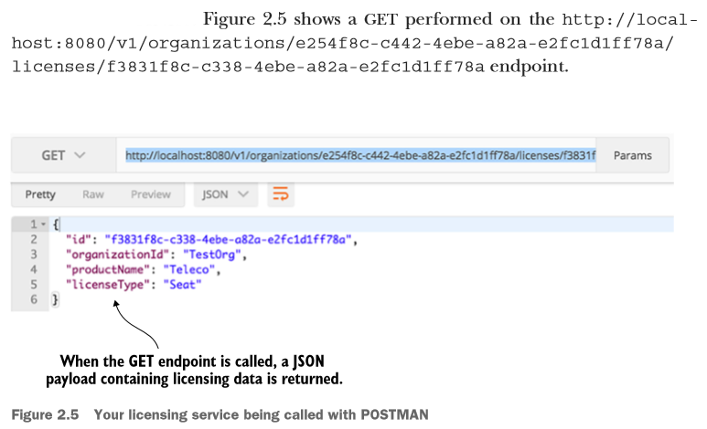
Building a microservice with Spring Boot and Java

Slide 22
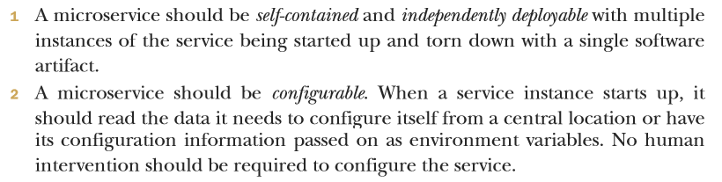
Building a microservice with Spring Boot and Java
Developing with four key principles:

Slide 23
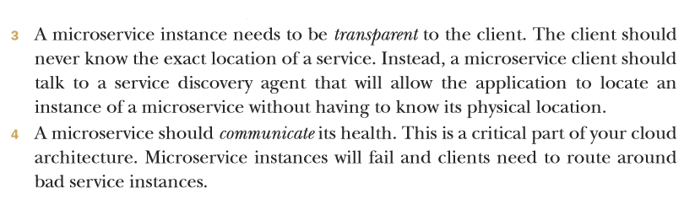
Building a microservice with Spring Boot and Java
Developing with four key principles:

Slide 24
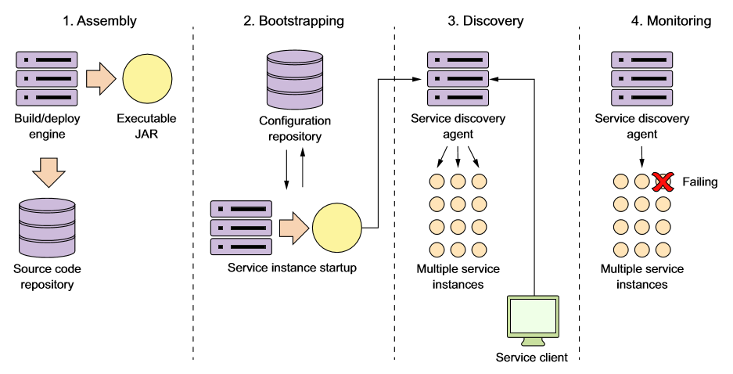
Building a microservice with Spring Boot and Java
The four principles can be mapped to the following operational lifecycle steps:

Slide 25
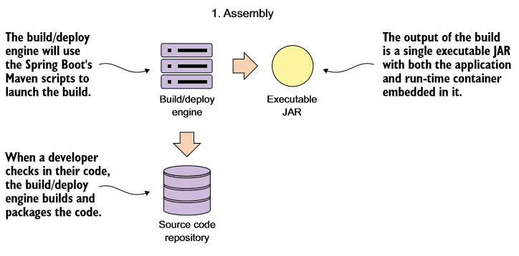
Service assembly: packaging and deploying your microservices

Slide 26
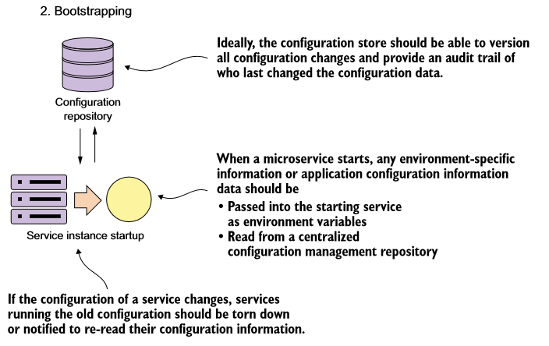
Service bootstrapping: managing configuration of your microservices

Slide 27
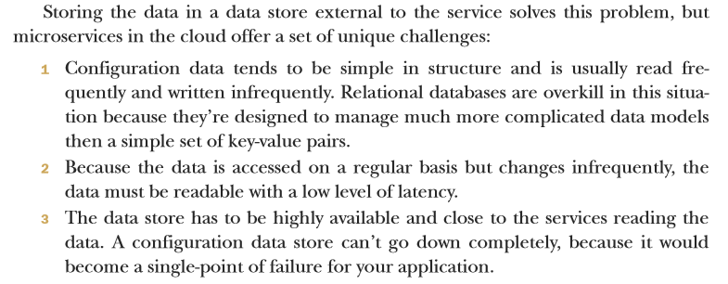
Service bootstrapping: managing configuration of your microservices

Slide 28
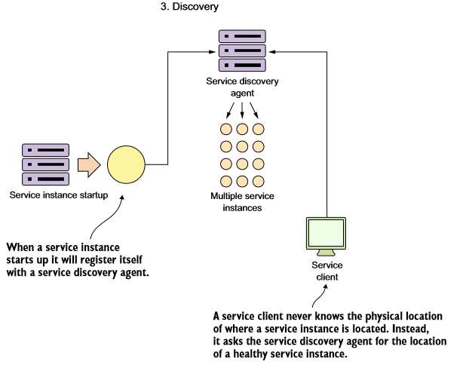
Service registration and discovery: how clients ommunicate with your mocroservices

Slide 29
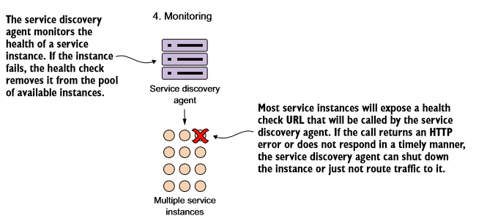
Communicating a microservice´s health

Slide 30
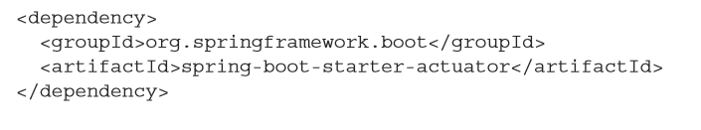
Communicating a microservice´s health
Spring Actuator provides out-of-the-box operational endpoints that will help you understand and manage the health of your service. To use Spring Actuator, you need to make sure you include the following dependencies in your Maven build file:

Slide 31
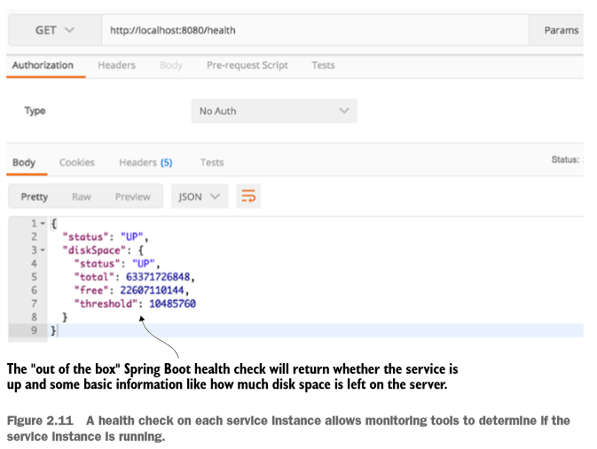
Communicating a microservice´s health

Slide 32
Controlling your configuration with Spring Cloud configuration server

Slide 33
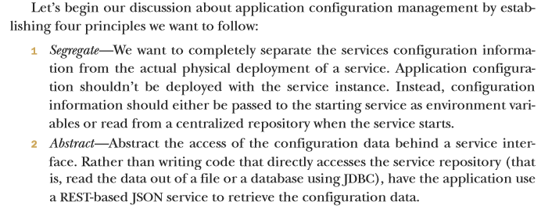
On managing configuration (and complexity)

Slide 34
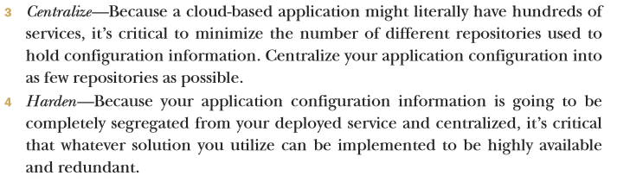
On managing configuration (and complexity)

Slide 35
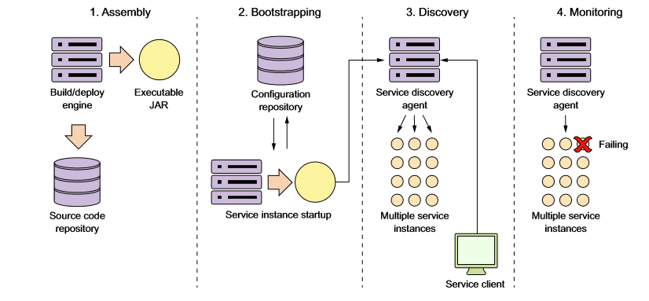
Microservice lifecycle

Slide 36
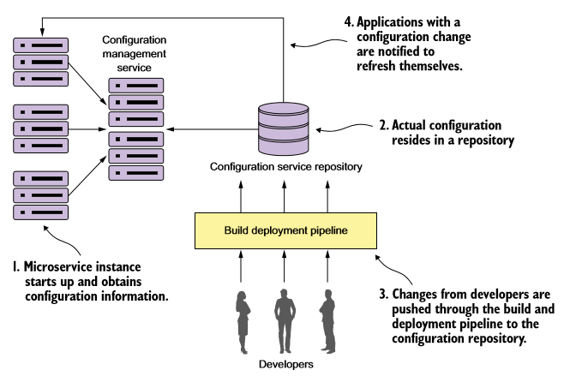
Configuration management conceptual architecture

Slide 37
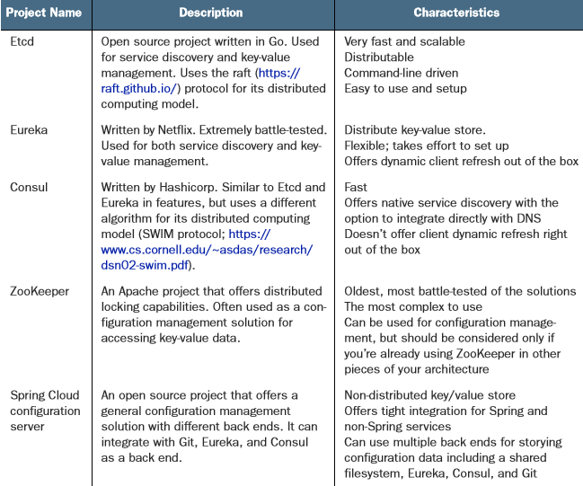
Implementation choices
In the following example we use the: Spring Cloud configuration server project

Slide 38
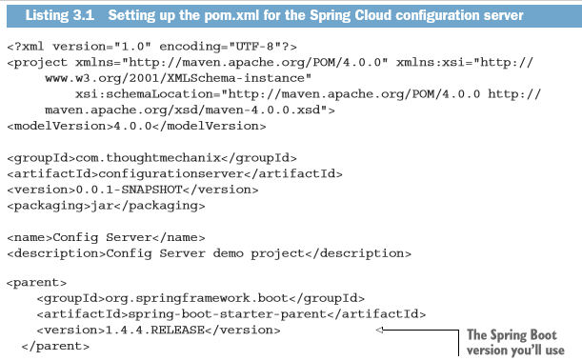
Building your Spring Cloud configuration server

Slide 39
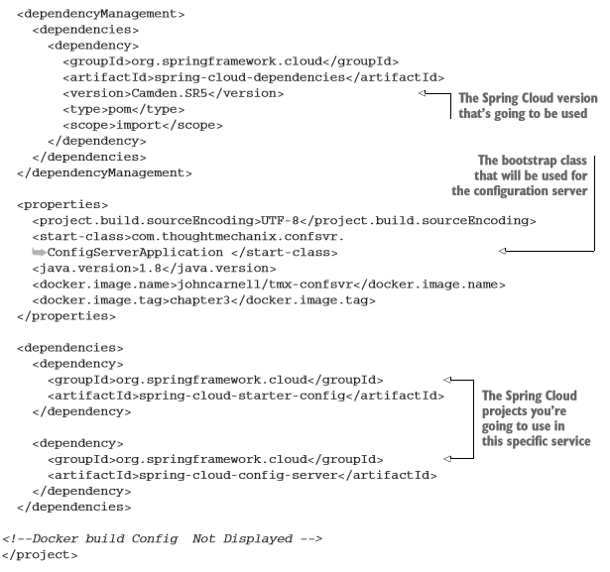

Slide 40
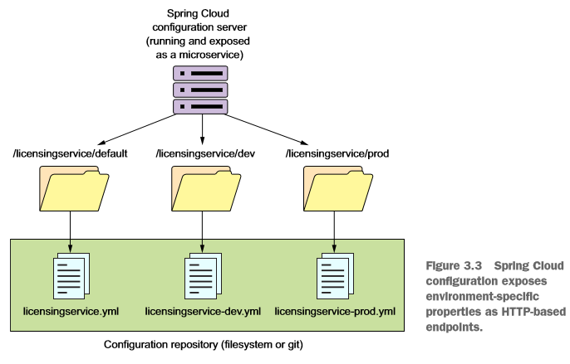
Building our Spring Cloud configuration server

Slide 41
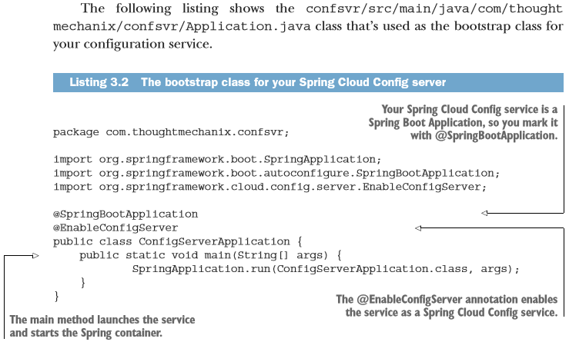
Setting up the Spring Cloud Config Bootstrap class

Slide 42
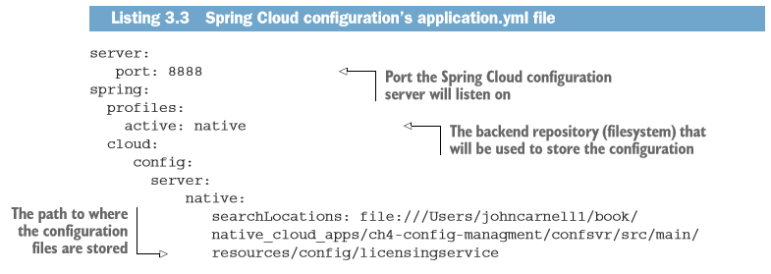
Using Spring Cloud configuration server with the filesystem

Slide 43
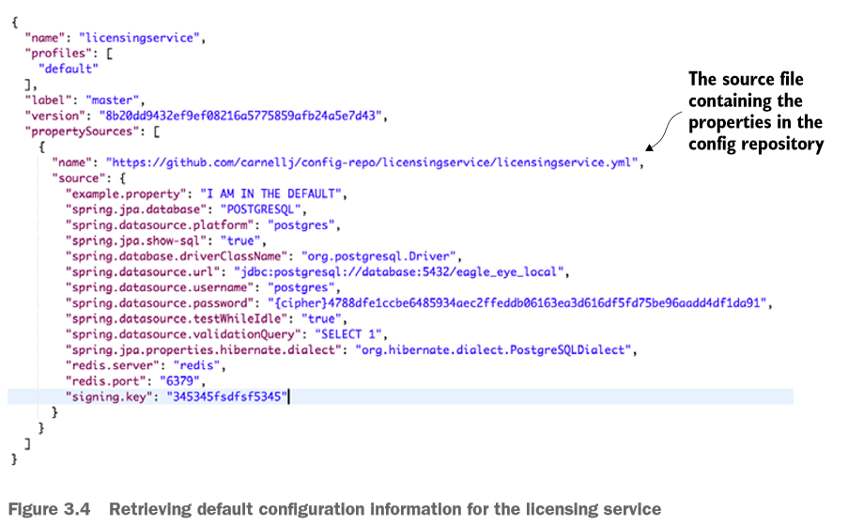
Using Spring Cloud configuration server with the filesystem

Slide 44
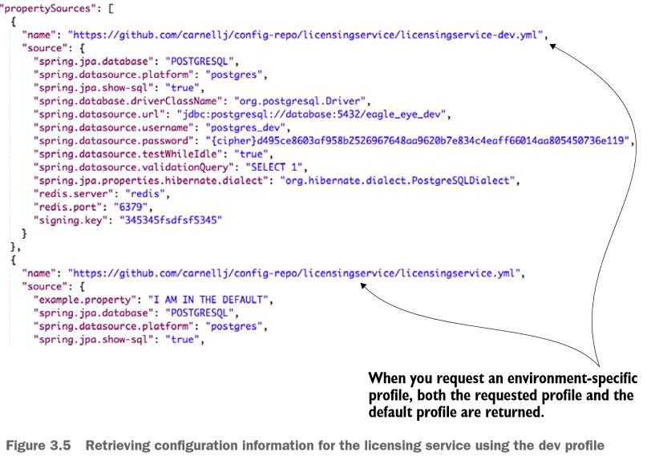

Slide 45
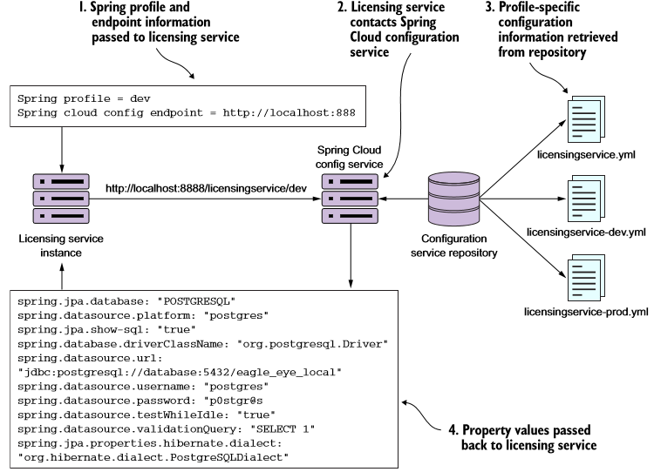
Integrating Spring Cloud Config with a Spring Boot client

Slide 46
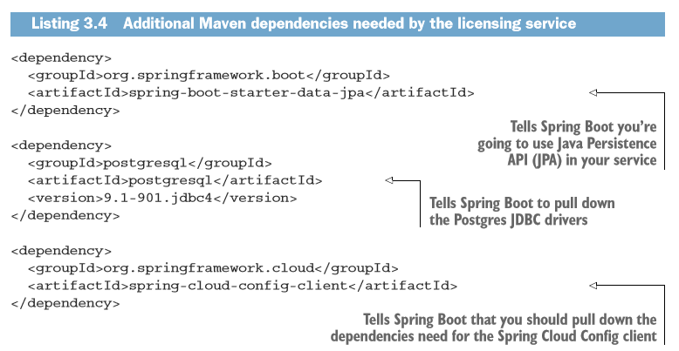
Setting up the licensing service Spring Cloud Config server dependencies

Slide 47
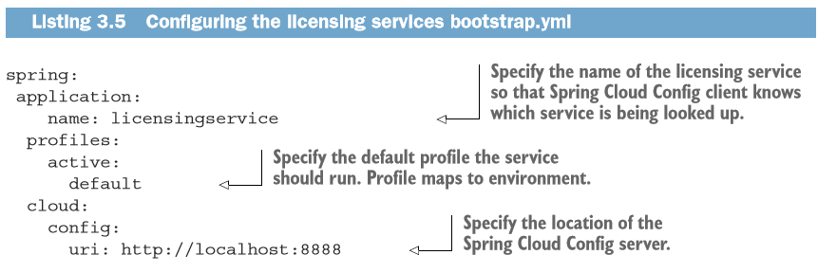
Configuring the licensing service to use Spring Cloud Config

Slide 48
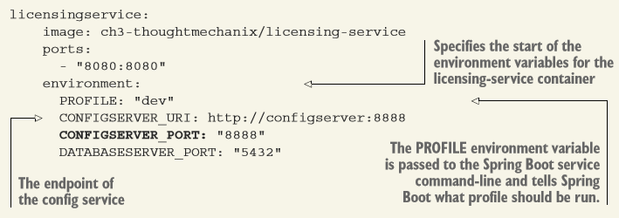
Use environment variables to pass startup information

Slide 49
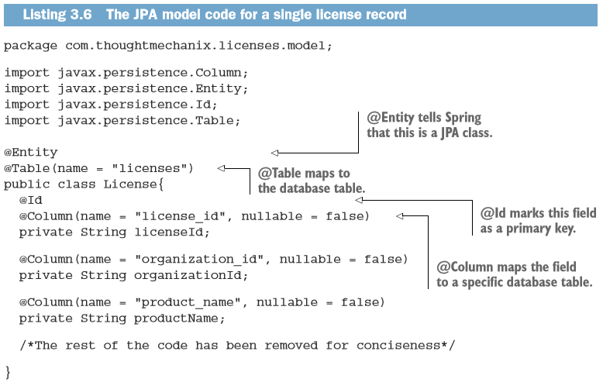
Wiring in a data source

Slide 50
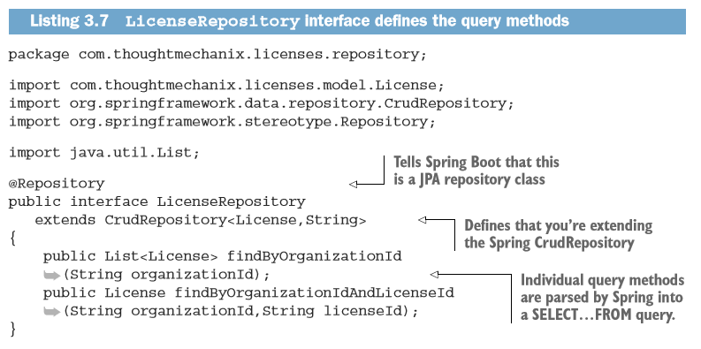
Wiring in a data source

Slide 51
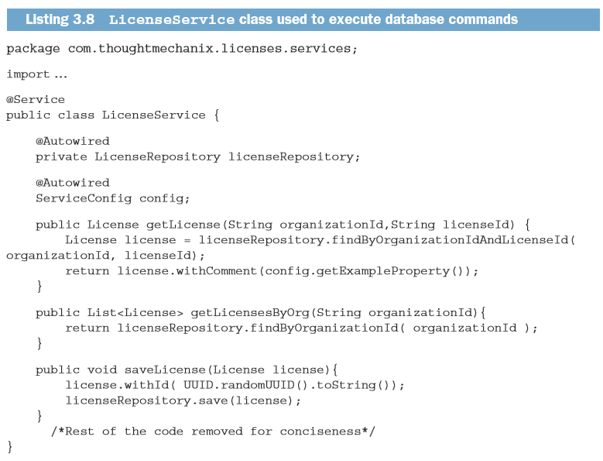
Wiring in a data source

Slide 52
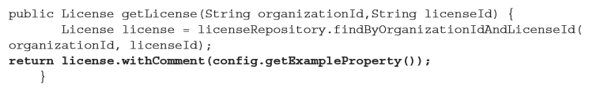
Directly Reading Properties using the @Value Annotation

Slide 53
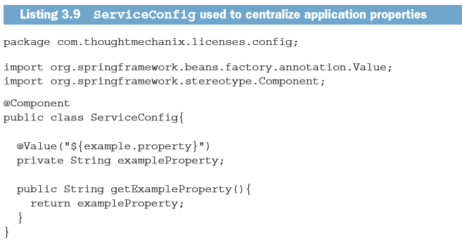
Directly Reading Properties using the @Value Annotation

Slide 54
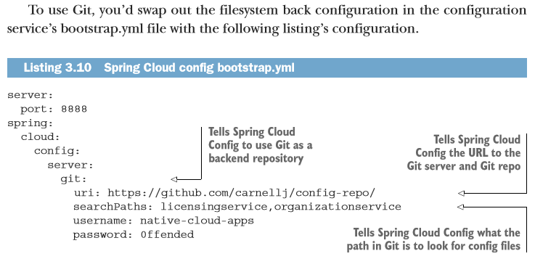
Using Spring Cloud configuration server with Git

Slide 55
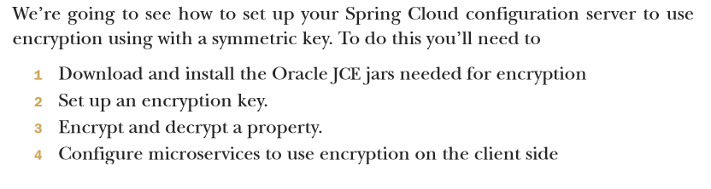
Protecting sensitive configuration information

Slide 56

Download and install Oracle JCE jars needed for encryption

Slide 57

Setting up an encryption key

Slide 58

Encrypting and decrypting a property

Slide 59

Configure microservices to use encryption on the client side

Slide 60

Configure microservices to use encryption on the client side
Include the spring-security-rsa JAR dependencies in with licensing service

Slide 61


Slide 62
On service discovery

Slide 63


Slide 64


Slide 65

Service discovery in action using Spring and Netflix Eureka

Slide 66

Building your Spring Eureka Service

Slide 67

Building your Spring Eureka Service

Slide 68

Building your Spring Eureka Service

Slide 69

Registering services with Spring Eureka

Slide 70

Registering services with Spring Eureka

Slide 71

Registering services with Spring Eureka

Slide 72

Using service discovery to look up a service

Slide 73

Using service discovery to look up a service

Slide 74

Looking up service instances with Spring DiscoveryClient

Slide 75

Spring DiscoveryClient

Slide 76

Invoking services with Ribbon-aware Spring RestTemplate

Slide 77

Invoking services with Ribbon-aware Spring RestTemplate

Slide 78

Invoking services with Netflix Feign client

Slide 79

Invoking services with Netflix Feign client

Slide 80
When bad things happen: client resiliency patterns with Spring Cloud and Netflix Hystrix

Slide 81

Client-side resiliency patterns

Slide 82

When bad things happen

Slide 83

When bad things happen

Slide 84
Enter Hystrix

Slide 85

Setting up the licensing server to use Spring Cloud and Hystrix
Import the Spring Hystrix dependencies in the pom.xml

Slide 86

Setting up the licensing server to use Spring Cloud and Hystrix
Annotate the service‘s bootstrap class with the @EnableCircuitBreaker

Slide 87

Implementing a circuit breaker using Hystrix
Hystrix sits between each remote resource call and protects the client. It doesn´t matter if the remote resource call is a database or a REST-based service call.

Slide 88

Implementing a circuit breaker using Hystrix

Slide 89

Implementing a circuit breaker using Hystrix

Slide 90

Implementing a circuit breaker using Hystrix

Slide 91


Timing out a call to the organization microservice

Slide 92

Customizing the timeout on a circuit breaker

Slide 93

Fallback processing

Slide 94

Fallback processing

Slide 95

Implementing the bulkhead pattern

Slide 96

Implementing the bulkhead pattern

Slide 97

Implementing the bulkhead pattern

Slide 98

Implementing the bulkhead pattern

Slide 99
Getting beyond the basics: fine-tuning Hystrix

Slide 100

The Hystrix flow

Slide 101

Configuring the behavior of a circuit breaker

Slide 102
Configuring the behavior of a circuit breaker

Slide 103

Hystrix configuration revisited

Slide 104

Hystrix configuration revisited

Slide 105

Configuration Values for @HystrixCommand Annotations

Slide 106

Configuration Values for @HystrixCommand Annotations

Slide 107

Thread context and Hystrix

Slide 108

ThreadLocal and Hystrix

Slide 109

Next slide

Slide 110


Slide 111

ThreadLocal and Hystrix

Slide 112

ThreadLocal and Hystrix

Slide 113

ThreadLocal and Hystrix
No value written out when calling a protected method.

Slide 114

The HystrixConcurrencyStrategy in action

Slide 115

Define your custom Hystrix concurrency strategy class

Slide 116

Define your custom Hystrix concurrency strategy class

Slide 117

Define your custom Hystrix concurrency strategy class

Slide 118

Define a Java Callable class to inject the UserContext into the Hystrix command

Slide 119

Configure Spring Cloud to use your custom Hystrix concurrency strategy

Slide 120

Configure Spring Cloud to use your custom Hystrix concurrency strategy

Slide 121

The HystrixConcurrencyStrategy in action

Slide 122
Service routing with Spring Cloud and Zuul

Slide 123

What is a services gateway?

Slide 124

What is a services gateway?

Slide 125

Introducing Spring Cloud and Netflix Zuul

Slide 126

Introducing Spring Cloud and Netflix Zuul

Slide 127

Setting up the Zuul Spring Boot project

Slide 128

Using Spring Cloud annotation for the Zuul service

Slide 129

Configuring Zuul to communicate with Eureka

Slide 130

Configuring routes in Zuul
Zuul at its heart is a reverse proxy.
A reverse proxy is an intermediate server that sits between the client trying to reach a resource and the resource itself.

Slide 131

Automated mapping routes via service discovery

Slide 132

Automated mapping routes via service discovery

Slide 133

Mapping routes manually using service discovery

Slide 134

Mapping routes manually using service discovery

Slide 135


Mapping routes manually using service discovery

Slide 136

Mapping routes manually using service discovery

Slide 137

Mapping routes manually using service discovery

Slide 138

Mapping routes manually using service discovery

Slide 139

Manual mapping of routes using static URLs

Slide 140

Manual mapping of routes using static URLs

Slide 141

Manual mapping of routes using static URLs

Slide 142

Manual mapping of routes using static URLs

Slide 143
The real power of Zuul: filters

Slide 144
The real power of Zuul: filters
Zuul supports three types of filters:
Pre-filters
Post filters
Route filters

Slide 145

Pre-filters

Slide 146

Post filters

Slide 147

Route filters

Slide 148


Slide 149

Figure 6.12 shows how these filters will fit together in processing requests to your EagleEye services.

Slide 150

Building your first Zuul pre-filter generating correlation IDs

Slide 151


Slide 152


Slide 153

Building your first Zuul pre-filter generating correlation IDs

Slide 154

Using the correlation ID in your service calls

Slide 155

UserContextFilter: Intercepting the incoming HTTP request

Slide 156


Slide 157

UserContext: making the HTTP headers easily accessible to the service

Slide 158


Slide 159

UserContext: making the HTTP headers easily accessible to the service

Slide 160


Slide 161

Custom RestTemplate and UserContextInteceptor: ensuring that the correlation ID gets propagated forward

Slide 163

Custom RestTemplate and UserContextInteceptor: ensuring that the correlation ID gets propagated forward

Slide 164


Slide 165


Building a post filter receiving correlation IDs

Slide 166


Slide 167


Slide 168


Slide 169

Building a dynamic route filter

Slide 170

Building the skeleton of the routing filter

Slide 171

Implementing the run() method

Slide 172


Slide 173

Forwarding the route

Slide 174


Slide 175

Pulling it all together

Slide 176
Securing your microservices

Slide 177
Introducing to OAuth2
OAuth2 is a token-based security authentication and authorization framework that breaks security down into four components. These four components are:
A protected resource
A resource owner
An application
OAuth2 authentication server

Slide 178

Introducing to OAuth2

Slide 179

Introducing to OAuth2

Slide 180
Using Spring and OAuth2 to protect a single endpoint

Slide 181

Setting up the EagleEye OAuth2 authentication service

Slide 182

Setting up the EagleEye OAuth2 authentication service

Slide 183

Setting up the EagleEye OAuth2 authentication service

Slide 184


Slide 185

Registering client applications with the OAuth2 service

Slide 186

Registering client applications with the OAuth2 service

Slide 187

Registering client applications with the OAuth2 service

Slide 188


Configuring EagleEye users

Slide 189


Slide 190

Authenticating the user

Slide 191

Authenticating the user

Slide 192

Authenticating the user

Slide 193


Slide 194

Protecting the organization service using OAuth2

Slide 195

Adding the Spring Security and OAuth2 jars to the individual services

Slide 196

Configuring the service to point to your OAuth2 authentication service

Slide 197


Slide 198


Defining who and what can access the service

Slide 199

Protecting a service by an authenticated user

Slide 200

Protecting a service by an authenticated user

Slide 201

Protecting a service by an authenticated user

Slide 202

Protecting a service via a specific role

Slide 203

Propagating the OAuth2 access token

Slide 204

Enable the OAuth2RestTemplate class

Slide 205



Slide 206


Slide 207

JavaScript Web Tokens and OAuth2
JWT tokens are:

Slide 208
JavaScript Web Tokens and OAuth2

Slide 209

Modifying the authentication service to issue JavaScript Web Tokens
Add the Spring Security dependency to the Maven pom.xml

Slide 210

Modifying the authentication service to issue JavaScript Web Tokens

Slide 211


Slide 212


Slide 213


Slide 214


Slide 215


Slide 216


Slide 217
Consuming JavaScript Web Tokens in your microservices
Creating a custom RestTemplate class to inject the JWT token in the licensing-service/src/main/java/com/thoughtmechanix/licenses/Application.java class

Slide 218


Slide 219


Slide 220

Extending the JWT Token

Slide 221


Slide 222

Extending the JWT Token
Tell the OAuth2 service to use the JWTTokenEnhancer class:

Slide 223


Slide 224

Parsing a custom field out of a JavaScript token
Add the JJWT library to the server´s pom.xml

Slide 225


Slide 226

Some closing thoughts on microservice security

Slide 227


Slide 228
Event-driven architecture with Spring Cloud Stream

Slide 229
The case for messaging, EDA, and microservices
As you look at implementing a caching solution, you realize you have three core requirements:
The cached data needs to be consistent across all instances of the licensing service
You cannot cache the organization data within the memory of the container hosting the licensing service
When an organization record changes via an update or delete, you want the licensing service to recognize that there has been a state change in the organization service

Slide 230

Using synchronous request-response approach to communicate state change

Slide 231

Using synchronous request-response approach to communicate state change

Slide 232


Slide 233

Downsides of a messaging architecture

Slide 234
Introducing Spring Cloud Stream

Slide 235


Slide 236


Slide 237

Writing a simple message producer and consumer

Slide 238

Writing the message producer in the organization service
Add the core Spring Cloud Stream and the Spring Cloud Stream Kafka libraries to the Maven pom.xml

Slide 239

Writing the message producer in the organization service

Slide 240


Slide 241


Slide 242


Slide 243


Slide 244


Slide 245

Writing a message consumer in the licensing service

Slide 246

Writing a message consumer in the licensing service

Slide 247


Slide 248

Writing a message consumer in the licensing service

Slide 249


Slide 250

Seeing the message service in action

Slide 251


Slide 252
A Spring Cloud Stream use case: distributed caching

Slide 253

Using Redis to cache lookups

Slide 254

Configure the licensing service with Spring Data Redis dependencies

Slide 255

Constructing the database connection to a Redis server

Slide 256

Defining the Spring Data Redis repositories

Slide 257

Defining the Spring Data Redis repositories

Slide 258


Slide 259


Slide 260


Slide 261

Using Redis and the licensing service to store and read organization data

Slide 262


Slide 263


Slide 264


Slide 265

Defining custom channels

Slide 266

Defining custom channels

Slide 267

Defining custom channels

Slide 268

Defining custom channels

Slide 269

Clearing the cache when a message is received

Slide 270


Slide 271
Distributed tracing with Spring Cloud Sleuth and Zipkin

Slide 272

Spring Cloud Sleuth and the correlation ID

Slide 273

Adding Spring Cloud sleuth to licensing and organization

Slide 274

Adding Spring Cloud Sleuth to licensing and organization

Slide 275

Anatomy of a Spring Cloud Sleuth trace

Slide 276
Anatomy of a Spring Cloud Sleuth trace
Application name of the service
Trace ID
Span ID
Whether trace data was sent to Zipkin

Slide 277

Anatomy of a Spring Cloud Sleuth trace

Slide 278

Log aggregation and Spring Cloud Sleuth

Slide 279


Slide 280

A Spring Cloud Sleuth/Papertrail implementation in action

Slide 281


Slide 282

Create a Papertrail account and configure a syslog connector

Slide 283


Slide 284


Slide 285

Redirecting Docker output to Papertrail

Slide 286


Slide 287

Searching for Spring Cloud Sleuth trace IDs in Papertrail

Slide 288

Adding the correlation ID to the HTTP response with Zuul

Slide 289


Adding the correlation ID to the HTTP response with Zuul

Slide 290


Slide 291


Slide 292
Distributed tracing with Open Zipkin

Slide 293

Setting up the Spring Cloud Sleuth and Zipkin dependencies

Slide 294

Installing and configuring a Zipkin server

Slide 295


Slide 296

Using Zipkin to trace transactions

Slide 297


Slide 298


Slide 299

Visualizing a more complex transaction

Slide 300

Visualizing a more complex transaction

Slide 301

Adding custom spans

Slide 302



Slide 303


Slide 304


Adding custom spans

Slide 305


Slide 306


Slide 307
Deploying your microservices

Slide 308

EagleEye: setting up your core infrastructure in the cloud

Slide 309

Creating the PostgreSQL database using Amazon RDS

Slide 310

Creating the PostgreSQL database using Amazon RDS

Slide 311

Creating the PostgreSQL database using Amazon RDS

Slide 312

Creating the PostgreSQL database using Amazon RDS

Slide 313

Creating the PostgreSQL database using Amazon RDS

Slide 314

Creating the PostgreSQL database using Amazon RDS

Slide 315

Creating the Redis cluster in Amazon

Slide 316

Creating the Redis cluster in Amazon

Slide 317

Creating an ECS cluster

Slide 318

Creating an ECS cluster

Slide 319


Slide 320


Slide 321

Creating an ECS cluster

Slide 322

Creating an ECS cluster

Slide 323

Deploying the EagleEye services to ECS manually

Slide 324

Deploying the EagleEye services to ECS manually

Slide 325

The architecture of a build/deployment pipeline

Slide 326

Your build and deployment pipeline in action

Slide 327

Enabling your service to build in Travis CI

Slide 328


Slide 330

Core build run-time configuration

Slide 331

Core build run-time configuration

Slide 332

Core build run-time configuration

Slide 333

Pre-build tool installations

Slide 334

Executing the build

Slide 335

Tagging the source control code

Slide 336

Building the microservices and creating the Docker images

Slide 337

Pushing the images to Docker Hub

Slide 338

Starting the services in Amazon ECS

Slide 339

Kicking off the platform tests

